Slide 1
Memory-Optimized TempDB for Faster Performance
Haripriya Naidu
She/Her
Database Administrator
CASSUG - 6/9/2025

Slide 2




Haripriya Naidu
SQL Database Administrator
11 years
AWS Certified Solutions Architect
Speaker
Blogger
gohigh.substack.com
linkedin.com/in/haripriya-naidu1215/
github.com/haripriyasb/MemoryOptimizedTempDB

Slide 3
Agenda
Purpose of this feature
Key benefits
Usage and Implementation
Limitations and Management Techniques
Level 300+

Slide 4
What we usually do
Noticed TempDB contention
Added datafiles
Wondered why it wasn’t solving the issue
Metadata contention → Enabling this feature

Slide 5
Memory Optimized TempDB Feature
New feature starting SQL 2019
Moves 12 system objects to memory
Latch-free & non-durable
Removes bottlenecks by handling metadata in memory

Slide 6
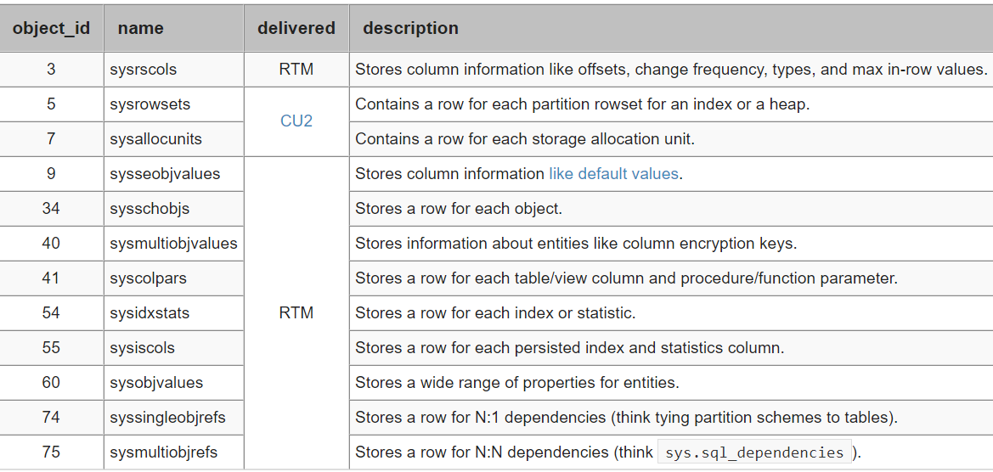
Memory Optimized TempDB Feature
https://www.mssqltips.com/sqlservertip/6230/memoryoptimized-tempdb-metadata-in-sql-server-2019

Slide 7
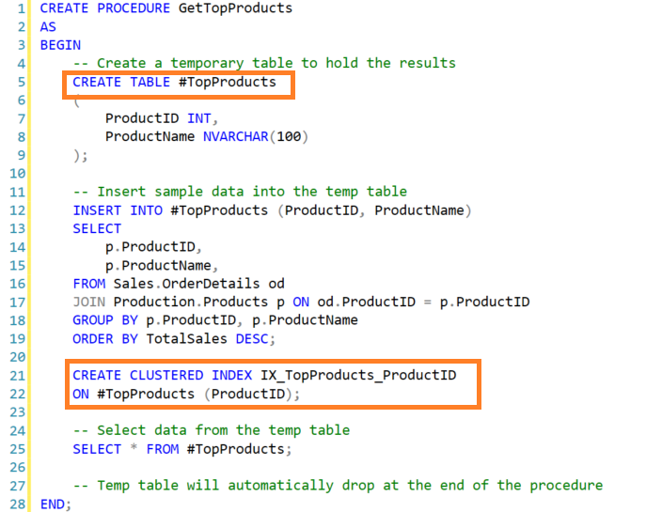
What happens internally
Create or alter #temp
Insert metadata
Get a pagelatch on system objects

Slide 8
1000s of concurrent executions
Create #temp
Alter #temp
Create #temp
Alter #temp
Create #temp
Alter #temp
Insert metadata
Contention
Get a pagelatch on system objects

Slide 9
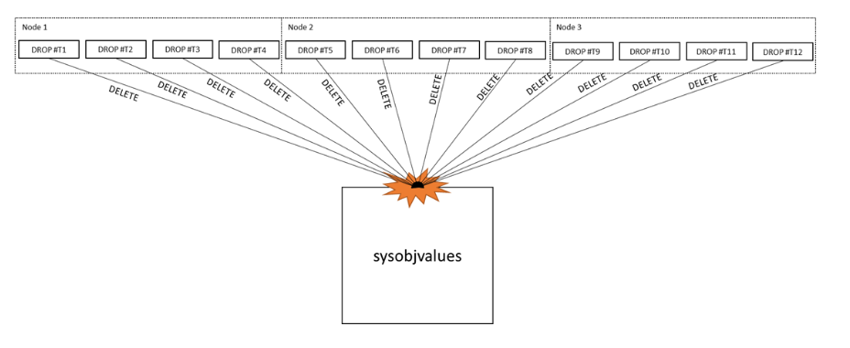

Slide 10
What’s the problem I’m solving?
Noticed TempDB contention
Added datafiles
Wondered why it wasn’t solving the issue
PFS GAM SGAM
Watch my video on TempDB Contention
PAGE
LATCH on TempDB
TempDB Contention: https://www.youtube.com/live/-3ap1_WWW40?si=LX61gxhrHysBsc8i
System objects
Memory Optimized TempDB Feature

Slide 11
Metadata Contention
PAGELATCHes on system objects
Too many create/alter/drop on temp objects

Slide 12
Memory Optimized TempDB Feature
Moving these system objects to memory
No need of PAGELATCHes
No contention

Slide 13
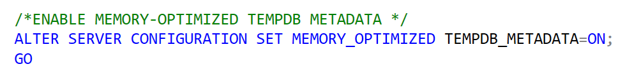
How to Enable this Feature
Disabled by default
Needs restart of SQL service after enabling
Hekaton DLL’s get configured
https://learn.microsoft.com/en-us/shows/data-exposed/how-and-when-to-memory-optimized-tempdb-metadata

Slide 14
Which Queries Utilize This Feature
DDL operation on temporary objects
CREATE TABLE #t
ALTER TABLE #t
DECLARE @v

Slide 15
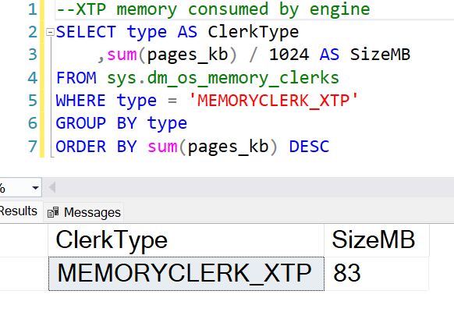
How much memory
Initially less than 100 MB
As temp object DDL
queries are run,
memory usage goes up

Slide 16
Where is it in memory
Separate part of memory
Not in buffer pool or cache
Initially around 100MB
No filegroup configuration needed

Slide 17
Why to Use This Feature
Latch free and Lock free
Less metadata contention
Better performance

Slide 18
When to Enable This Feature
Too many stored procedures run concurrently where there are temp table DDLs
Usually, very busy OLTP environments
Check your collections or monitoring tool

Slide 19
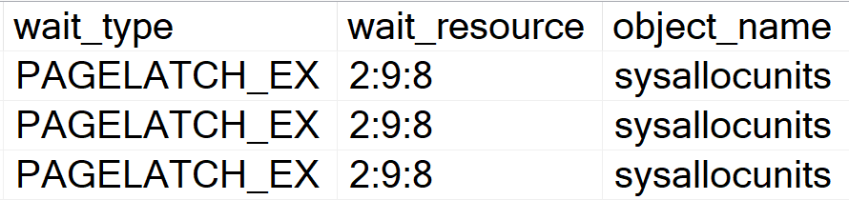
When to Enable This Feature
Strictly for
TempDB
PAGELATCH wait type
12 System Objects

Slide 20
Supported Versions and Editions
SQL 2019+
Enterprise
Developer
Feature NOT available in
Standard Edition
Azure SQL database
Azure SQL Managed Instance

Slide 21
Resource Pool
Limit memory usage
CREATE RESOURCE POOL tempdb_resource_pool WITH (MAX_MEMORY_PERCENT = 70);
ALTER RESOURCE GOVERNOR RECONFIGURE;

Slide 22
Resource Pool
Bind Resource Pool to TempDB
ALTER SERVER CONFIGURATION SET MEMORY_OPTIMIZED TEMPDB_METADATA = ON (RESOURCE_POOL = 'tempdb_resource_pool’);
Restart SQL Service!

Slide 23
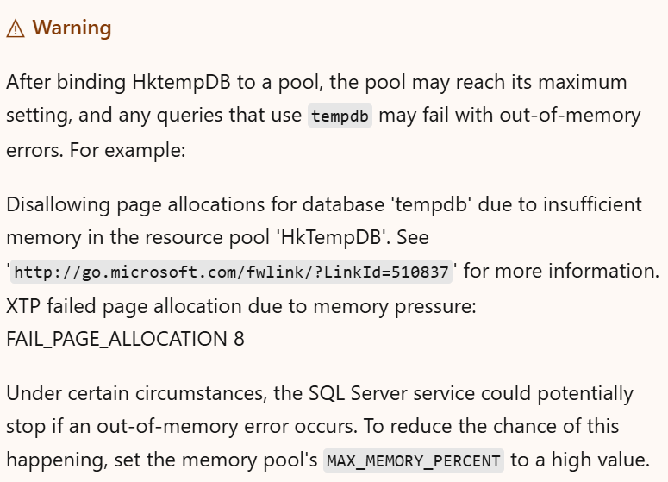
https://learn.microsoft.com/en-us/troubleshoot/sql/database-engine/performance/memory-optimized-tempdb-out-of-memory

Slide 24
PAGE
LATCH?
Flowchart - Bird’s View
YES
TempDB?
RESOLVED IN SQL 2022
YES
PFS GAM ? SGAM
Add 4 datafiles of equal size
Check Contention
Add 4 more datafiles of equal size
YES
YES
NO
System objects?
Cache #temp Don’t drop #temp
Check Contention
In-memory tempdb metadata feature in SQL2022
YES
YES

Slide 25
DEMO
SQL 2022
With feature disabled
Run SP with temp tables
Run SP with table variables
Capture contention graph
Repeat with feature enabled
Compare performance
Memory Cleanup
Issues with Memory Cleanup
Limitations

Slide 26
Results
Scenario | Without Memory-Optimized Metadata | With Memory-Optimized Metadata
Temp Table runtime | High | Low
Table Variable runtime | Low | Low
PAGELATCH Contention | High | Low
Query Performance | Slow | Fast

Slide 27
It’s a feature not a bug!
XTP memory grows without limit and can cause restart
9:00 Transaction 1 – sleeping , not committed, 2 GB
9:01 Transaction 2 – committed, 2GB
9:02 Transaction 3 – committed, 3GB
9:03 Transaction 4 – committed, 2GB
9:04 Transaction 5 – committed, 1GB
Cannot cleanup due to the earliest transaction still uncommitted
10GB is held without releasing

Slide 28
Manage this feature efficiently
Jobs | Schedule
Execute sys.sp_xtp_force_gc to release memory | Once every 30 mins
Terminate long open sleeping transactions(find repeat offenders) | Once every 2-3 days

Slide 29
Proactive Monitoring
Set up a SQL Agent job to:
Alert when XTP memory exceeds 10% of max server memory.
Check for idle transactions lingering for over 5 hours.
Log session details to a table and send you a notification.
GitHub link to the script - https://github.com/haripriyasb/MemoryOptimizedTempDB/blob/main/MonitoringXTPMemory

Slide 30
When NOT to use this feature
When there are explicit DDL transactions with temp tables running for a long time
Temp Tables with Columnstore clustered indexes

Slide 31
Do this before you enable
Strongly recommend to cache temporary objects
Avoid dropping temp tables at the end of stored procedure
TempDB Contention: https://www.youtube.com/live/-3ap1_WWW40?si=LX61gxhrHysBsc8i

Slide 32
Summary
PAGELATCHes on system objects
Too many stored procedures running concurrently
Not for PFS, GAM, SGAM pages
Disabled by default
Needs restart to take effect
Doesn’t need filegroups
Ensure feature is enabled on secondary/passive nodes
Works with table variables and temp tables
No performance difference with table variables
Significant performance improvement with temp tables

Slide 33
Summary – Contd.
Temp tables with Columnstore indexes don’t work
In-memory user tables NOT compatible with in-memory tempdb in same transaction
Resource pool to limit memory usage
Keep transactions short
Available from SQL 2019+
Best to enable in SQL 2022
Developer or Enterprise Edition
Setup jobs to manage feature
Terminate long open sleeping transactions
Release memory - EXEC sys.sp_xtp_force_gc

Slide 34
Learn more
https://learn.microsoft.com/en-us/sql/relational-databases/databases/tempdb-database?view=sql-server-ver16#memory-optimized-tempdb-metadata
https://learn.microsoft.com/en-us/sql/relational-databases/databases/tempdb-database?view=sql-server-ver16#limitations-of-memory-optimized-tempdb-metadata
https://learn.microsoft.com/en-us/troubleshoot/sql/database-engine/performance/memory-optimized-tempdb-out-of-memory
TempDB Contention: https://www.youtube.com/live/-3ap1_WWW40?si=LX61gxhrHysBsc8i

Slide 35
Questions?
gohigh.substack.com
linkedin.com/in/haripriya-naidu1215/
https://github.com/haripriyasb/MemoryOptimizedTempDB/
Thank You!

